Slide 1
Sofonisba Anguissola
(1535/1536−1625)

Slide 2
Sofonisba Anguissola
Earlier women artists
− Ende ( “Ende pintrix et Dei aiutrix…”), Beato de Tábara (975)
− Guda ( “Guda, a sinner wrote and painted this book”) (12th-century Homeliary)
− Hildegard von Bingen (1098−1179)
−Herrad von Landsberg (d. 1170)
−Teresa Díaz ( “Teresa Dieç me fecit”)

Slide 3
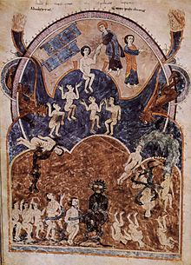
Ende ( “Ende pintrix et Dei aiutrix…”), Beato de Tábara (975)
“The Last Judgment” from the Gerona Beatus

Slide 4
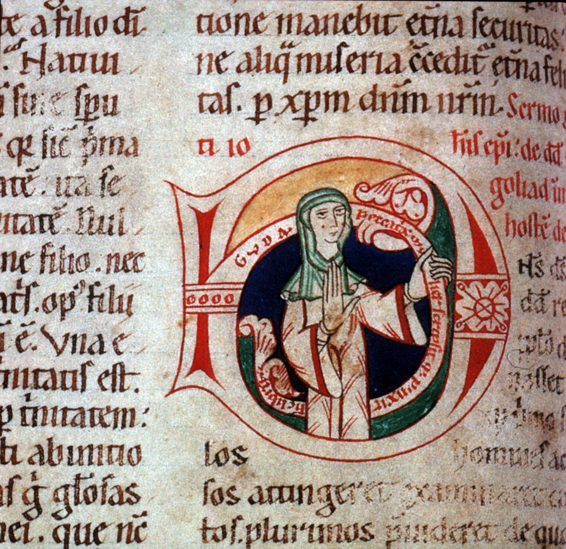
Guda (12th century) Self-portrait
“Guda, a sinner wrote and painted this book” (12th-century Homeliary), Frankfurt, Staatsbibliothek, MS. barth. 45

Slide 5
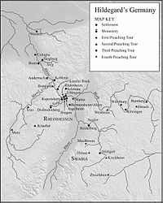
Hildegard von Bingen (1098−1179)
Hildegard’s Germany

Slide 6
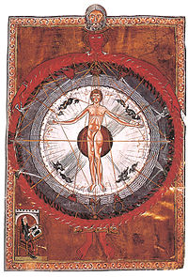
Hildegard von Bingen (1098−1179)
“Universal Man” illumination from Hildegard’s Liber Divinorum
Operum, I.2. Lucca, MS 1942 (early 13th century copy)

Slide 7
Hildegard von Bingen (1098−1179)
“Universal Man” illumination from Hildegard’s Liber Divinorum
Operum, I.2. Lucca, MS 1942 (early 13th century copy)

Slide 8
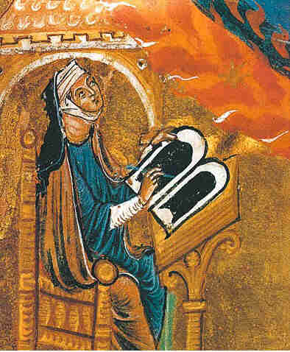
Hildegard von Bingen (1098−1179)
“Universal Man” illumination from Hildegard’s Liber Divinorum
Operum, I.2. Lucca, MS 1942 (early 13th century copy)
Self-portrait

Slide 9
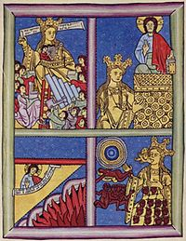
Hildegard von Bingen (1098−1179)
The Church, the Bride of Christ and Mother of the Faithful in
Baptism. Illustration to Scivias II.3, fol. 51r

Slide 10
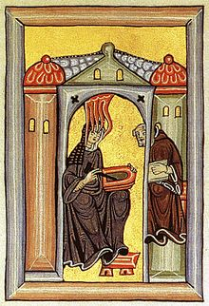
Hildegard von Bingen (1098−1179)
Scivias (1142−1152), Rupertsberg manuscript, fol. 1r:
“From the sky came brilliant fire and a voice said to me: Write what you see….”

Slide 11
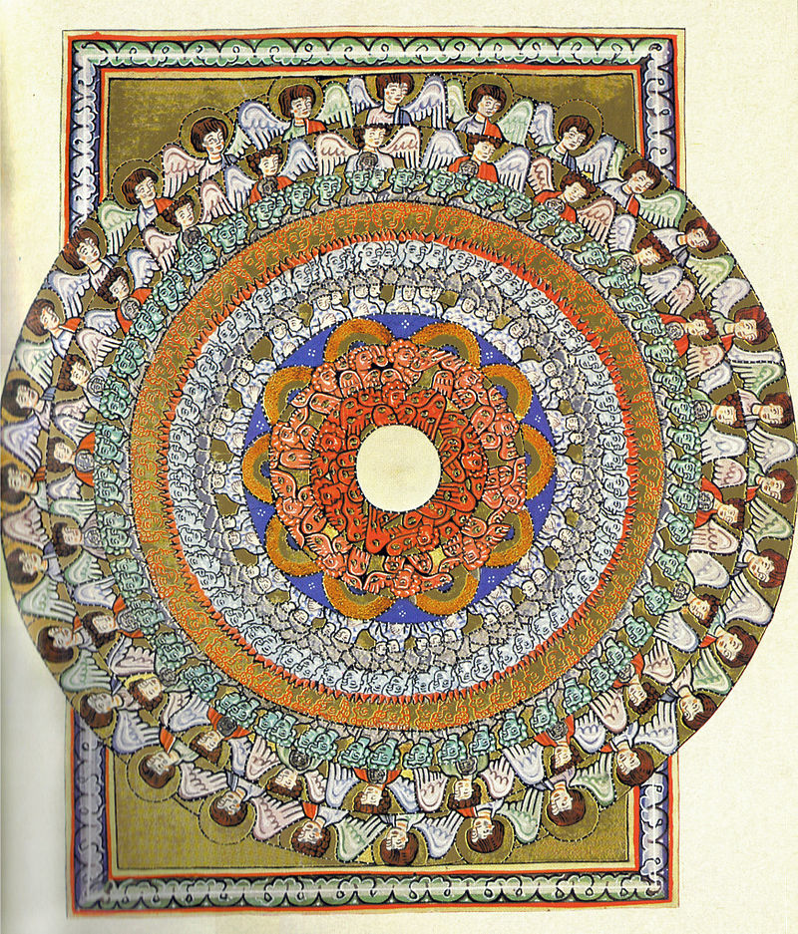
Hildegard von Bingen (1098−1179)
Choir of Angels from Scivias, Rupertsberg manuscript, fol. 38r

Slide 12

Hildegard von Bingen (1098−1179)
Lingua ignota

Slide 13
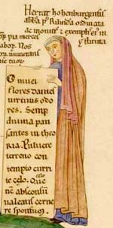
Herrad von Landsberg (d. 1170)
Self-portrait from Hortus delicarium (ca. 1180), fol. 322: “Herrat hohenburgensis abbatissa post Rilindam ordinata ac monitis et exemplis eius instituta”

Slide 14
Teresa Díaz ( “Teresa Dieç me fecit”)

Slide 15
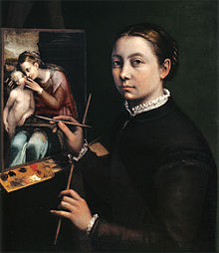
Sofonisba Anguissola
Self-portrait (1556),
Lancut Musem, Poland

Slide 16
Sofonisba Anguissola
−Female artist of aristocratic family in Cremona
−Grandfather was ennobled
−Father legitimized
−Father had her and five sisters educated in Latin, music, and painting

Slide 17
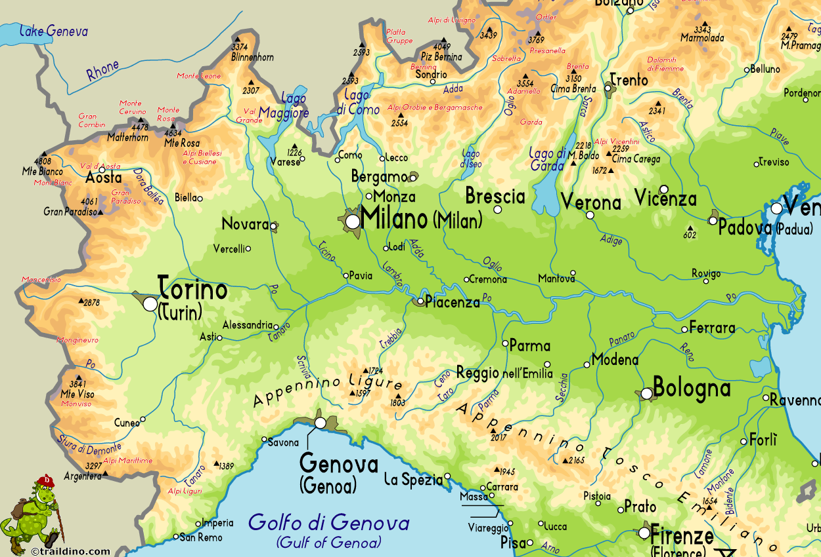
Northern Italy

Slide 18
Sofonisba Anguissola
Father: Amilcare
− Elena → convent
− Lucia → painter but died young (at age of 29)
− Minerva → Latin scholarly writings
− Anna Maria → gets married
− Europa →
Asdrubale (1551)

Slide 19
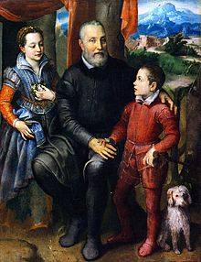
Sofonisba Anguissola
Family Portrait, Minerva, Amilcare, and Asdrubale Anguissola (1557)

Slide 20
Sofonisba Anguissola
Why did the father Amilcare educate his daughters?
Renaissance ideas about aristocratic conduct and education
−Castiglione, Book of the Courtier (1528)
Bk. 2: “Lady of the Palace”
−Enhancing nobility and honor of family
−Financial difficulty of six dowries
−Accomplished women more marriageable
−Careers to support themselves and help family
−Father actively promotes daughters’ fame

Slide 21
Sofonisba Anguissola
−Sofonisba and her sister Elena are given lessons by the leading painter of Cremona, Bernardino Campi (1522−1591)
−not apprenticed
−had to be properly chaperoned

Slide 22
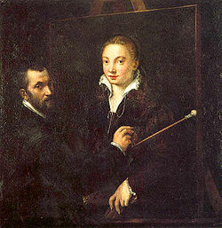
Sofonisba Anguissola
Portrait of Bernadino Campi painting a portrait of Sofonisba Anguissola

Slide 23
Sofonisba Anguissola
−Later, Sofonisba trained with Bernardio Gatti (1495−1576)
−1559: She was invited to travel to Spain as a lady-in-waiting and court painter to newly crowned Queen Isabella de Valois

Slide 24
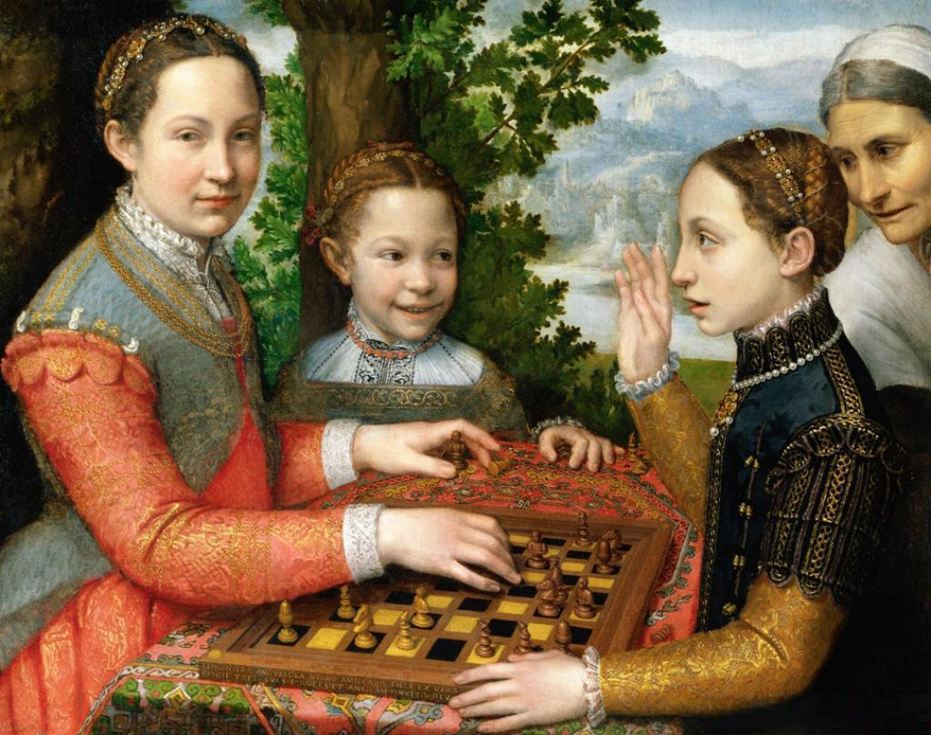
Lucia, Minerva, and Europe Playing Chess (1555)

Slide 25
Sofonisba Anguissola
− Ivenzione ( “invention” or originality)
−Unusual to show three daughters without parents
−properly chaperoned
−anticipates 17th-century genre painting
−quotidian
−Narrative interaction
−Lucia making a move
−Minerva raises her hand
−Europa is smiling

Slide 26
Sofonisba Anguissola
Lecture: Hull, “ARTH 4117”
<https://www.youtube.com/watch?v=fDFN1ZteJ0k&list=
PLAjrswY6TkLDG8UbfjCTSRhar745jgWCI&index=19>
<https://www.youtube.com/watch?v=f3gdf7clQd8&index=20&list=
PLAjrswY6TkLDG8UbfjCTSRhar745jgWCI>
<https://www.youtube.com/watch?v=ZAixJOW7O94&index=21&list=
PLAjrswY6TkLDG8UbfjCTSRhar745jgWCI>.

Slide 27
Artemisia Gentileschi (1593−ca. 1652)
−Italian baroque painter
− Daughter of the painter Orzio Gentilschi
−Worked in Rome, Florence, Genoa, Naples, and London
−Heroic women as subjects

Slide 28
Artemisia Gentileschi (1593−ca. 1652)
−Important follower of Caravaggio
−naturalism and tenebrism
−Spread of Caravaggio’s style in Florence, Genoa, and Naples
−Her father hired Agostino Tasso to teach her perspective
−Tasso raped her
−Orazio brought a court case for damages to himself
−Torture; Agostino found guilty and sentence to six months in jail

Slide 29
Artemisia Gentileschi (1593−ca. 1652)
https://www.youtube.com/watch?v=KldzQxoS5-U

