Slide 1
Origins of European Art

Slide 3
Byzantine Empire
A. Aspects of Byzantine Life
1. Constantinople — The City = 15
a. Hagia Sophia
b. Hippodrome (Blues and Greens)
c. Greek fire
2. Prosperous Trade
3. Harmony of Church and State
a. state administration (basileus)
b. external administration of the Church (basileus + patriarch)
c. religious doctrine (patriarch)
4. Successor of Rome

Slide 4
Byzantine Achievements
1. Codified Roman Law
2. Preserved Much of Ancient Greek Culture
3. Fostered Art and Architecture

Slide 5
Constantinople during Byzantine Empire (reconstruction)

Slide 6
The Kingdom of Christ on Earth
1. Basileus (Emperor) (chooses patriarch)
2. Patriarch of Constantinople (advises basileus)

Slide 7
Spheres of Responsibility

Slide 8
II. Split between Eastern Church and Western Church
A. Reflects Division within the Roman Empire
1. Administration
2. Language: Greek vs. Latin
3. Trade
B. Major Points of Disagreement

Slide 9
Christianity to A.D. 600

Slide 10
Breakup of Roman Empire

Slide 11
B. Major Points of Disagreement (top ten)
1. Language of Liturgy
2. Ritual
3. Two Swords Theory vs. Harmony of Church and State
4. Clerical Celibacy vs. Married Priests
5. Unleavened Bread vs. Leavened Bread
6. Statues vs. Icons
7. Role of Pope (i.e., bishop of Rome)
8. Filioque Clause
9. Calendar
10. Relationship of Reason to Faith

Slide 12
Byzantine Empire under Justinian (527–565)

Slide 13
Byzantine Iconoclasm
Chludov Psater (9th century)

Slide 14
Iconoclast Controversy (8th and 9th centuries)
−“First Iconoclasm” (from 726 to 787)
−Emperor Leo III (r. 717−741) issued edicts against the veneration of images (726−729)
−Pope Gregory II (r. 715−731) excommunicated and anathematized the iconoclasts (730, 732)
−Leo transferred Southern Italy and Illyricum to the patriarchate of Constantinople
−Exarchate of Ravenna detached itself from Byzantine Empire
−Iconoclast synod (Council of Hieria) of 754

Slide 15
Council of Hieria (754)
−called by Emperor Constantine V (r. 741−775)
The Council declared:
“the unlawful art of painting living creatures blasphemed the fundamental doctrine of our salvation − namely, the Incarnation of Christ, and contradicted the six holy synods…. If anyone shall endeavor to represent the forms of the Saints in lifeless pictures with material colors which are of no value (for this notion is vain and
introduced by the devil), and does not rather represent their virtues as living images in himself, etc.… Let him be anathema.”

Slide 16
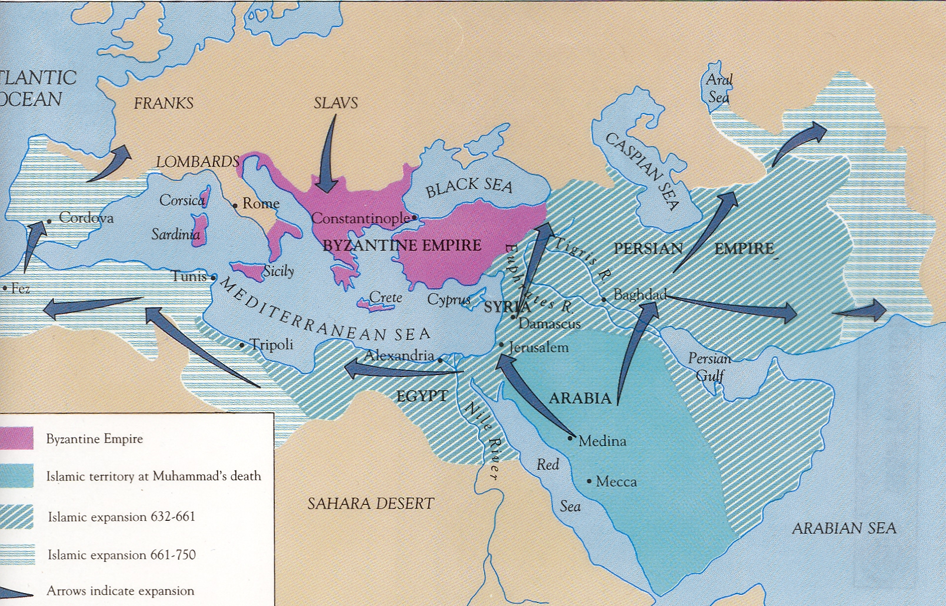
Expansion of Islam to 750

Slide 17
First restoration of icon use and veneration
−Irene of Athens
−regent 780−797
−summoned two councils to resolve the issue
786: Council of Constantinople − disrupted
787: Second Council of Nicaea (Seventh Ecumenical Council)

Slide 18
Second Council of Nicaea (787)
“As the sacred and life-giving cross is everywhere set up as a symbol, so also should the images of Jesus Christ, the Virgin Mary, the holy angels, as well as those of the saints and other pious and holy men be embodied in the manufacture of sacred vessels, tapestries, vestments, etc., and exhibited on the walls of churches, in the homes, and in all conspicuous places, by the roadside and everywhere, to be revered by all who might see them. For the more they are contemplated, the more they move to fervent memory of their prototypes. Therefore, it is proper to accord to them a fervent and
reverent adoration, not, however, the veritable worship which, according to our faith, belongs to the Divine Being alone — for the honor accorded to the image passes over to its prototype, and whoever venerate the image venerate in it the reality of what is there represented.”

Slide 19
Iconoclast Controversy (8th and 9th centuries)
−“Second Iconoclasm” (from 814 to 842)
−Emperor Leo V (r. 813−825):
“all the emperors, who took up images and venerated them, met their death either in revolt or in war; but those who did not venerate images all died a natural death, remained in power until they died, and were then laid to rest with all honors in the imperial mausoleum
in the Church of the Holy Apostles.”
−opposed by Patriarch Nikephoros I (r. 806−815)
−deposed
−Council of Constantinople (815) − banned icons

Slide 20
Iconoclast Controversy (8th and 9th centuries)
853: Second restoration of icon veneration under Theodora, regent from 842 to 855
−compromise reached
−no statuary
−production of icons to be strictly regulated in order to emphasize spiritual rather then worldly aspects of person(s) being represented

Slide 21
Characteristics of icons

Slide 22
Christ Pantocrator (1260s) Chelandari Monastery

Slide 23
Theotokos (Byzantine 11th century)

Slide 24
Theotokos of Vladimir (12th Century)

Slide 25
Christ the Savior (Andrei Rublev, 1410s)

Slide 26
How to Read an Icon
David J. Birnbaum
djbpitt@pitt.edu
http://clover.slavic.pitt.edu/~djb/
2009-11-07

Slide 27
Deësis, Russia, 16th Century
Notes:
Pantocrator (vsederzhitel’) in center
To left: Mary, Michael, Peter, Basil the Great
To right: John the Baptist, Gabriel, Paul, John Chrysostom
Deësis = ‘supplication’

Slide 28
Outline
Materials and technology
Theology
Extra-personal and personal details (cf. textual fixed epithets)
Inscriptions
Representation of space and time
Representations of holy figures

Slide 29
Materials and Technology
Board (with splines [шпонки] to prevent warping)
Plaster grounding (gesso [левкас])
Egg tempera paint
Mineral and other pigments
Gilding
Silver cover (оклад)

Slide 30
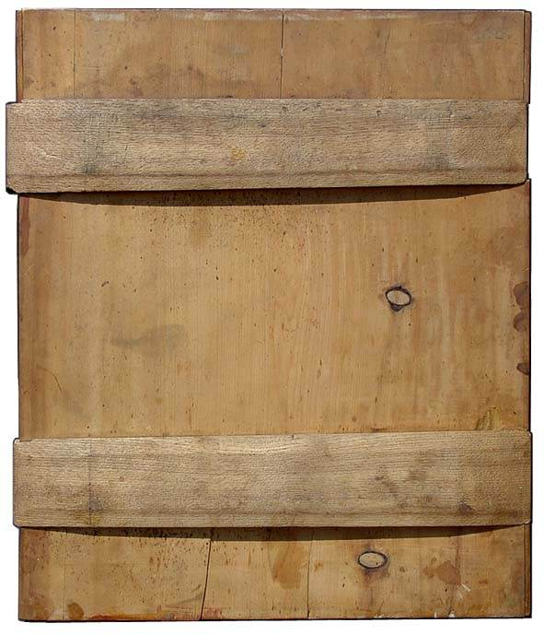
Splines (шпонки)

Slide 31
Theology
St. Luke the Evangelist is the first icon painter
Icon of the Theotokos
Icons are “uncovered,” not painted or created
The artist is the vehicle, not the creator
Icons are painted according to instructions in manuals (подлинники), and not according to the “artist’s” inspiration

Slide 32
Extra-Personal and Personal Details
Extra-personal details
Indicate type of saint (bishop, monk, martyr, etc.)
Clothing (e.g., bishop’s stole)
Personal details
Distinguish individual saint from others of the same rank or type
Specific facial features (e.g., shape of beard)

Slide 33
Inscriptions
Labels (титлы)
abbreviated names of holy figures
Jesus (ΙΣ ΧΣ) and Mary (ΜΡ ΘΥ) are labeled in Greek, even on Russian icons
Other labels are usually Russian
Descriptions
Longer texts describing events (e.g., “Beheading of John the Baptist”)
Literacy was limited in Rus′; inscriptions were not necessarily intended to be read

Slide 34
Convention
More important figures are generally larger and depicted toward the center (“hierarchy”)
More important figures undergo less distortion than, for example, background objects
Faces of more important figures are generally turned toward the viewer
Synecdochic representation
Synecdoche: part represents the whole
Notes:
Important figures may be larger than horses, or even buildings
Faces are turned toward the viewer to establish spiritual contact
Uspensky 60
Synecdoche = part represents whole (metonymy is any association); e.g., crowd of saints represented by crowd of haloes

Slide 35
Perspective
−Summary point of view from multiple perspectives
−What could be seen from all sides, not just one
−May be called multiple, summary, dynamic (or inverted) perspective
−Varieties
Spatial (different sides are visible simultaneously)
Temporal (events that are separated in time are depicted in a single image)
(Cf. Cubism, montage)
Notes:
Not an individual perspective, but a summary point of view from multiple perspectives (Uspensky 34)
Perspective is based on what could be seen from all sides, not on what could be seen by a specific viewer in a specific place
Makes sense as a representation of an object’s place in the world
Cf. binocular vision
Left and right in manuals are from inside the image (reverse of what we assume today) (Uspensky 36)
Summation is Uspensky’s term (49 ff), and applies to both space and time. Montage (Uspensky 53).

Slide 36
What’s the Point?
Why do icons look the way they do?
−Representations not of objects, but of the place of objects in the world
Painter’s / viewer’s literal perspective is not privileged
Internal point of view
No single perspective
Left and right are internal
No shadows because no external source of light
Objects recede from the center in all directions
Notes:
Perspective is based on what could be seen from all sides, not on what could be seen by a specific viewer in a specific place
Makes sense as a representation of an object’s place in the world
Icons are not signed, and they are not painted, but “uncovered”
Internal point of view: shrinking and distortion toward perimeter = farther from point of view
Uspensky 35

Slide 37
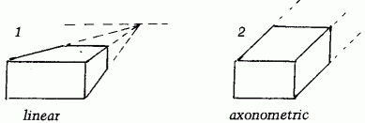
Overview of Perspectives
Notes:
Guillem Ramos-Poqui, “The Technique of Icon Painting.” 54
Converging perspective is from within the picture, converging on the viewer (the person praying)
Also: Bird’s-eye view

Slide 38
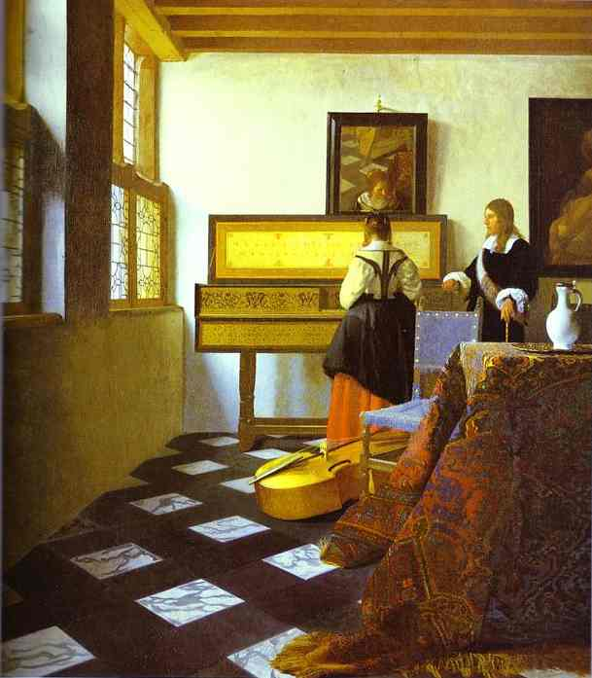
Linear Perspective
Jan Vermeer (Dutch, 1632–1675)
The Music Lesson (c.1662–1665)
Notes:
Jan Vermeer. 1632–75. The Music Lesson. c.1662–1665. Oil on canvas. Royal Collection, St. James' Palace, UK.
Not binocular.
Not ocular (very sharp convergence, not regular field of vision)

Slide 39
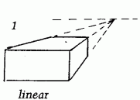
Linear Perspective
Notes:
Jan Vermeer. The Music Lesson. c.1662-1665. Oil on canvas. Royal Collection, St. James' Palace, UK.
Perspective (variation in size between fore- and background) is exaggerated.

Slide 40
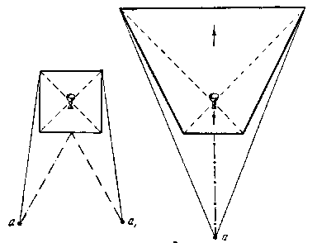
Summary (Converging) Perspective
Both sides visible
Converging perspective (toward viewer)
Center shifts forward
Front narrows
Notes:
Uspensky p. 64
Square deformed into trapezoid
Cup moves forward

Slide 41
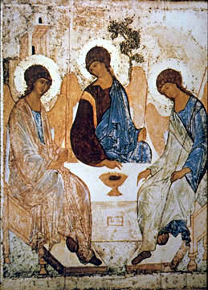
Inverted (Summary) Perspective
Andrei Rublev (Russian 1360? –1430)
Old Testament Trinity (early fifteenth century)
Notes:
Both sides visible
Converging perspective
Cup shifts forward
Front narrows
(Oak of Mamre)

Slide 42
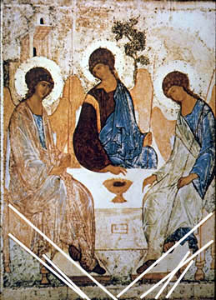
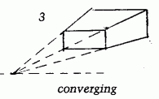
Inverted (Summary) Perspective

Slide 43
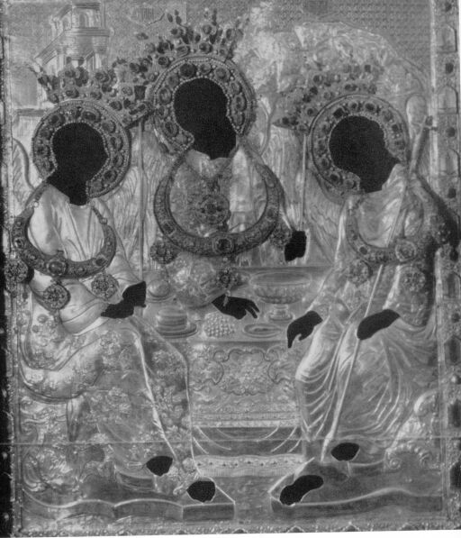
Forward Shift
Oklad for Rublev’s Old Testament Trinity
Notes:
Zhegin, plate viii-и, xvi–xvii c.

Slide 44
Andrey Rublev (1360s−1427, 1428, or 1430)
−no evidence of where he was born
−probably lived in the Trinity St. Sergius Monastery
−first mention of Rublev in 1405 as decorating icons and frescos for the Annunciation Cathedral in the Moscow Kremlin
−along with Theophanes the Greek and Prokhor of Gorodets

Slide 45
Theophanes the Greek (Feofan Grek) (ca. 1340−ca. 1410)
−born in Constantinople
−lived for 30 years in Rus’
−According to Epifanii Premudryi (the Wise) (d. 1420), “That man Feofan Grek is a truly wise man and a shrewd philosopher. An exceedingly nice book iconographer and a skillful icon painter. He painted murals for many a church: for some 40-odd stone churches in Constantinople and Chalcedon, in Galati, in Haifa, in Nizhnyi Novgorod, and in Great Novgorod and in Moscow too. When he depicted something or somebody, nobody ever saw any models before his face as usually happens with other icon painters who look to and fro in hesitation. And they would rather contemplate models than apply paints. Feofan’s hands were busy painting all the time. He would pace up and down and talk with people. And his reason would grasp things above us. He would perceive with his eyes the meaningful beauty.”

Slide 46
Theophanes the Greek (Feofan Grek) (ca. 1340−ca. 1410)
Transfiguration of Jesus (1408)

Slide 47
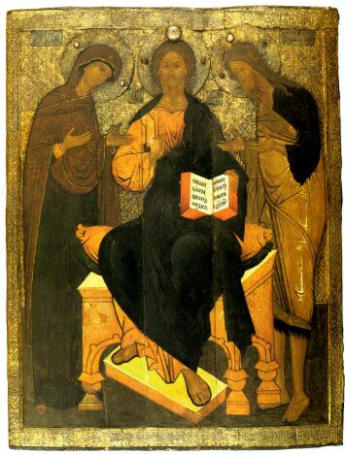
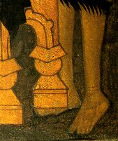
Ouch!
Deësis, xvi c. Velikii Ustiug
Notes:
Deësis: Jesus, Mary to his right, John the Baptist to his left
Velikii Ustiug School, 16th c
Wood, gesso, tempera
“Palekh Icon Painting,” plate 7
Leg of stool overlaps foot
Note twisting of feet and footstool of Christ

Slide 48
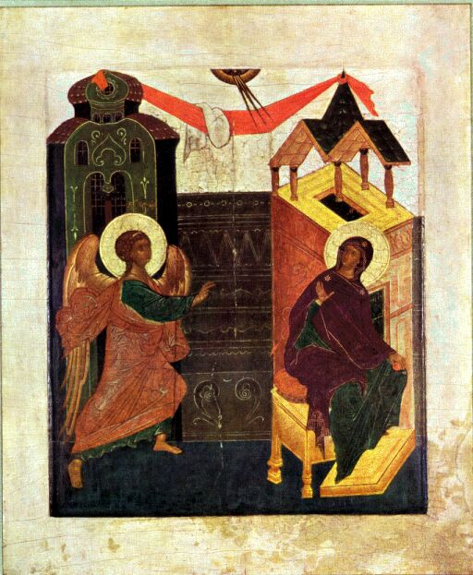
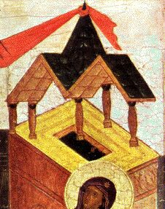
Floating Pillars
Annunciation, xvi c.
Notes:
(Russian xvi c., private collection, Uspensky and Lossky)
She is seated (superiority), raising hand to indicate initial non-acceptance (in other versions she drops yarn in surprise or places palm on breast to signal final acceptance)
Sphere is heaven and rays above are Holy Spirit
Red cloth is veil, indicating inside location (as does building)
Buildings are aligned with figures in center, since propinquity imposes importance, but the roof, further away, is more “natural” (although the five pillars are peculiar)
Mary reaches almost to the roof
Background is tilted forward to avoid falling off rear; thus top of building (cf. icon hillocks)

Slide 49
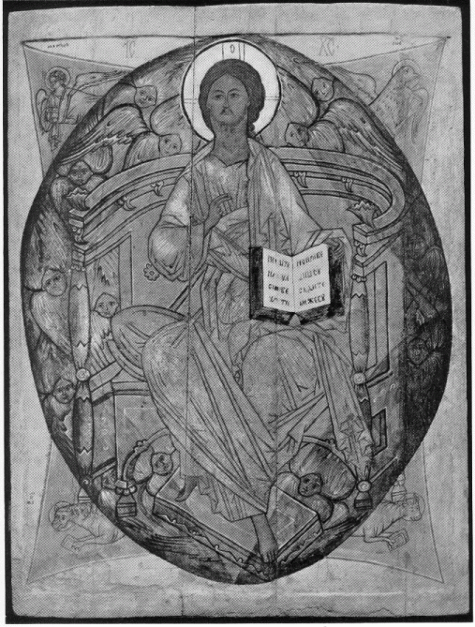
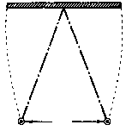
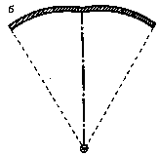
Broken Curve
Christ Pantocrator, xvi c.
Notes:
Zhegin, p. 45
Christ Pantocrator, Ouspensky and Lossky, p. 72
Russian, xvi c, 31 x 40 in. Metropolitan Museum of Art (Gift if George R, Hahn)

Slide 50
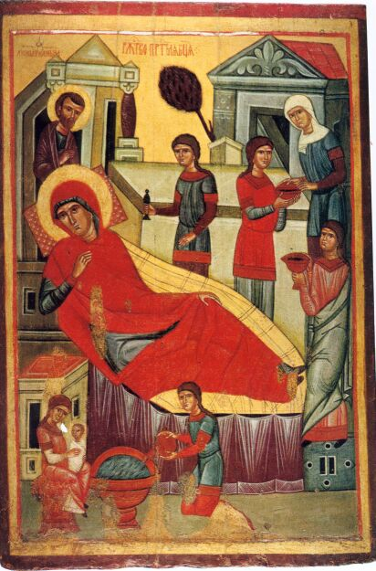
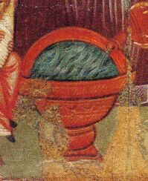
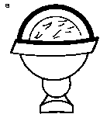
Vertical Shift
Nativity of the Mother of God 1st half of xiv c.
Notes:
“Novgorodian Icon Painting,” plate 19
Nativity of the Virgin
Wood, tempera, 1.13 x 0.75
First half of xiv, Tretyakov Gallery, Moscow
Zhegin, p. 51
St. Anna on bed, swaddled kid in arms of midwife near water basin

Slide 51
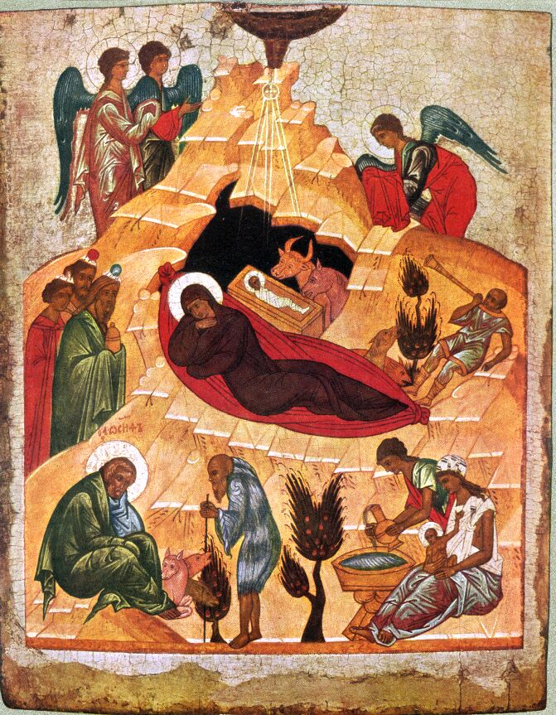
Icon Hills (Иконные горки)
Nativity
Novgorod xv c.
Notes:
Ouspensky and Lossky, p. 160
The ground may actually be flat; it is shifted up because of shifting perspective, and the shift happens in pieces, creating the illusion of hills, because the image breaks up when it shifts, so that pieces of the ground are viewed separately.

Slide 52
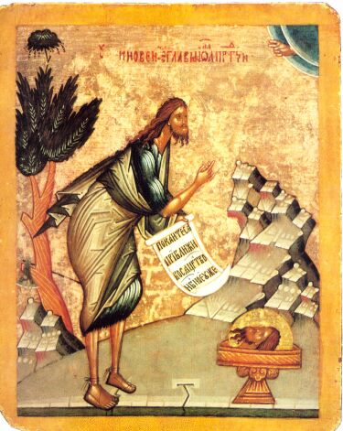
Multiple Heads
Beheading of John the Baptist
Novgorod End of xv c.
Notes:
“Continuous style” (Boguslavskii)
Comic strip
Beheading of John the Baptist
“Repent, for the heavenly kingdom is coming”
End of xv c, Novgorod
Heavily-primed canvas
Russian Museum, St. Petersburg
Novgorodian Icon Painting, plate 77

Slide 53
Narrative − one person appears two or more times in same frame
“Moses receives the law” − 10th-century Byzantine icon

Slide 54
Narrative − one person appears two or more times in same frame
“Moses receives the law” − 10th-century Byzantine icon

Slide 55
Narrative − one person appears two or more times in same frame
“Moses receives the law” − 10th-century Byzantine icon

Slide 56
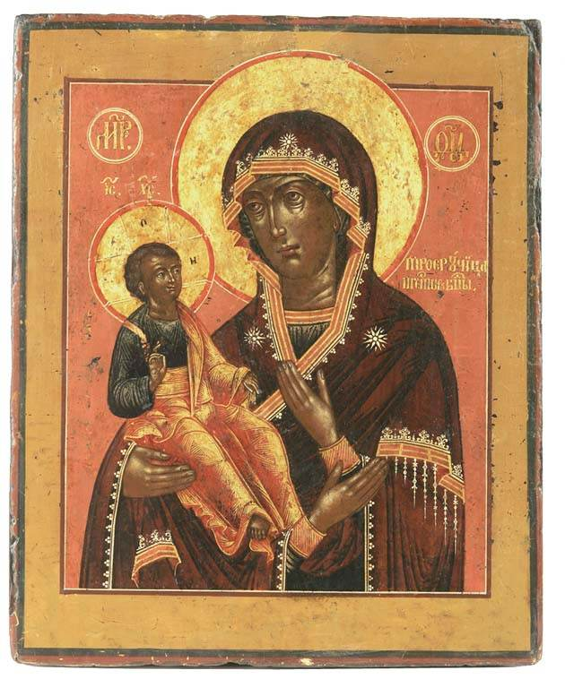
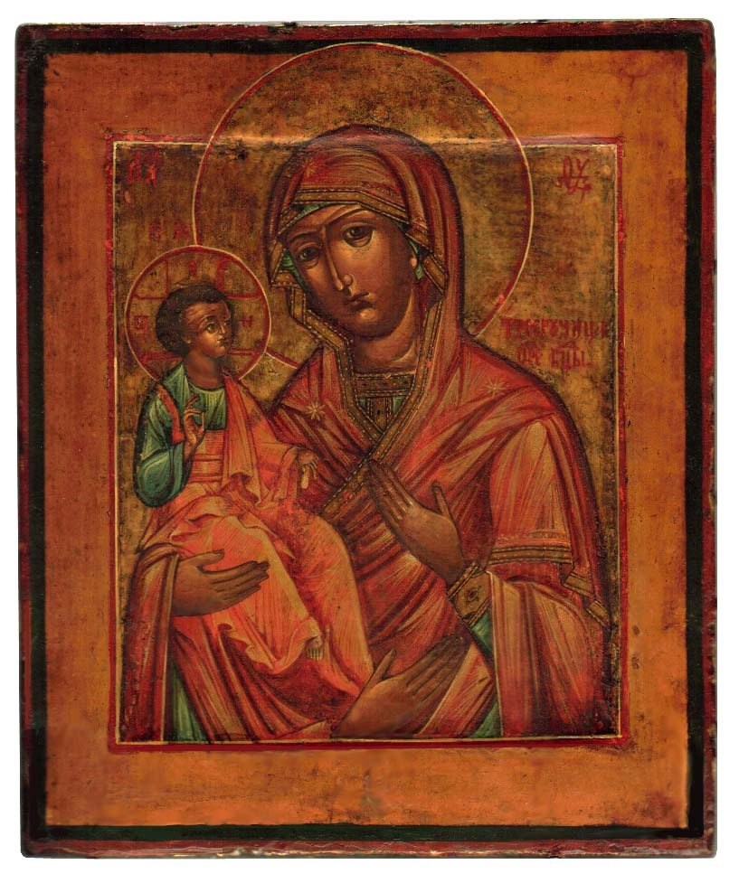
Multiple Hands (Троеручица)
Notes:
Russian, xviii c., http://digilander.libero.it/giotonelli1/mani2.jpg, link from http://digilander.libero.it/bianco14/01e.html
Russian, xix c.
http://digilander.libero.it/bianco14/tremani3.jpg (link from http://digilander.libero.it/bianco14/01e.html)
Archetype is at Hilandar, picture (in oklad, alas) in Medieval Serbian Culture.

Slide 57
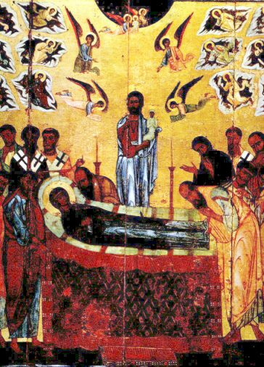
Multiple Souls
Dormition of the Mother of God (Cropped)
Novgorod, early xiii c.
Notes:
Dormition of the Mother of God
Wood. Egg tempera. 1.55 x 1.28.
Early xiii c.
Tretyakov Gallery, Moscow. Novgorodskaia ikonopis’. Plate #11.

Slide 58
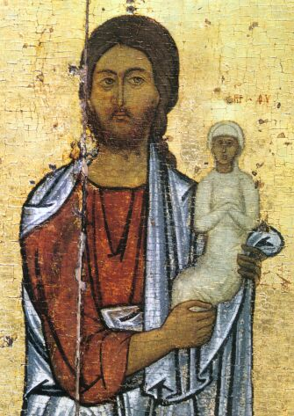
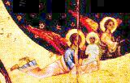
Multiple Souls
Dormition of the Mother of God (Details)
Novgorod, early xiii c

Slide 59
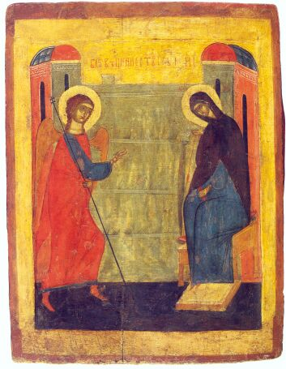
Russian Annunciation
xiv–xv c.
Notes:
“Palekh Icon Painting,” plate 2
Rostov-Suzdal’ (?), xiv-xv, wood, gesso, tempera, gilded
Figures face forward, not toward each other, but bodies turned toward each other
Facial frontality (Uspensky, 73): Faces (eyes?) of scared figures must be visible for contact during prayer
Annunciation took place indoors, but exterior of building represents interior (Uspensky 66)
Scale indicates importance; even foreground figures would not have approached the height of a building

Slide 60
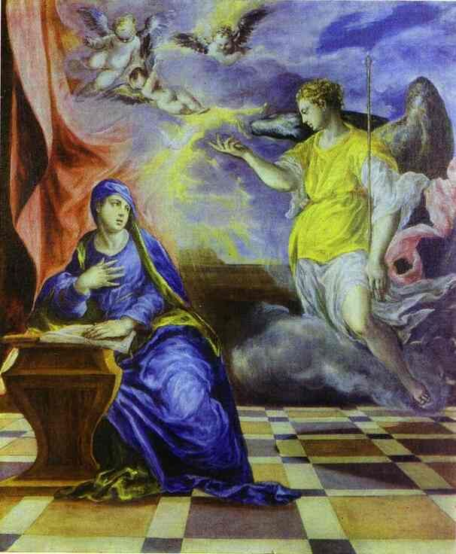
El Greco Annunciation
1570–1575
Notes:
El Greco. (Spanish-Greek, 1541-1614) The Annunciation. 1570-1575. Oil on canvas. Thyssen-Bornemisza Collection, Lugano-Castagnola, Switzerland.
Mary is 3/4 face, but with eyes toward Gabriel. Gabriel is true profile.

Slide 61
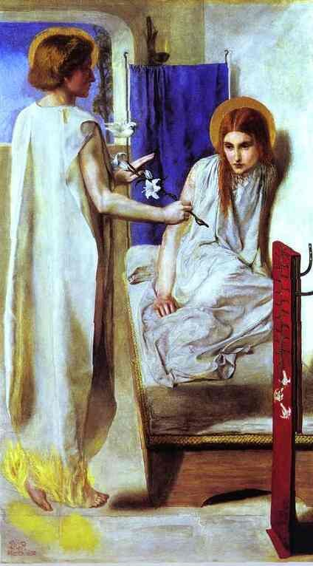
Rossetti Annunciation
1850
Notes:
Dante Gabriel Rossetti (English, 1828–1882). Ecce Ancilla Domini ("The Annunciation"). 1850. Oil on canvas. Tate Gallery, London, UK.
Gabriel’s eyes are barely visible, turned more than halfway from viewer. Mary looks down.

Slide 62
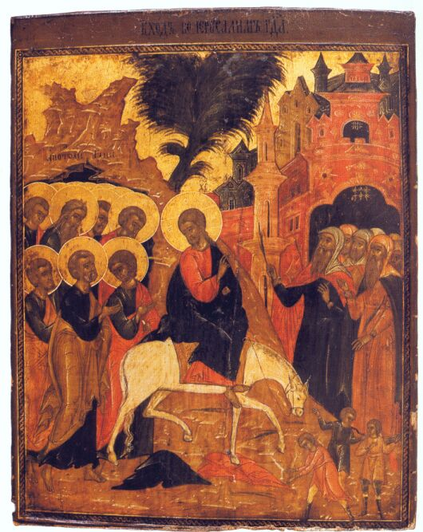
Synecdoche
Entry into Jerusalem
Palekh First half of xviii c.
Notes:
Entry into Jerusalem
Palekh school, first half of xviii c
Wood, gesso, tempera, gilded
“Palekh Icon Painting,” plate 41
Twelve haloes for apostles, but not twelve people (or even heads)
Citizens greet him with palm branches, children spread garments in his path (Matt. 21: 8 doesn’t specify children, but garments are spread)

Slide 63
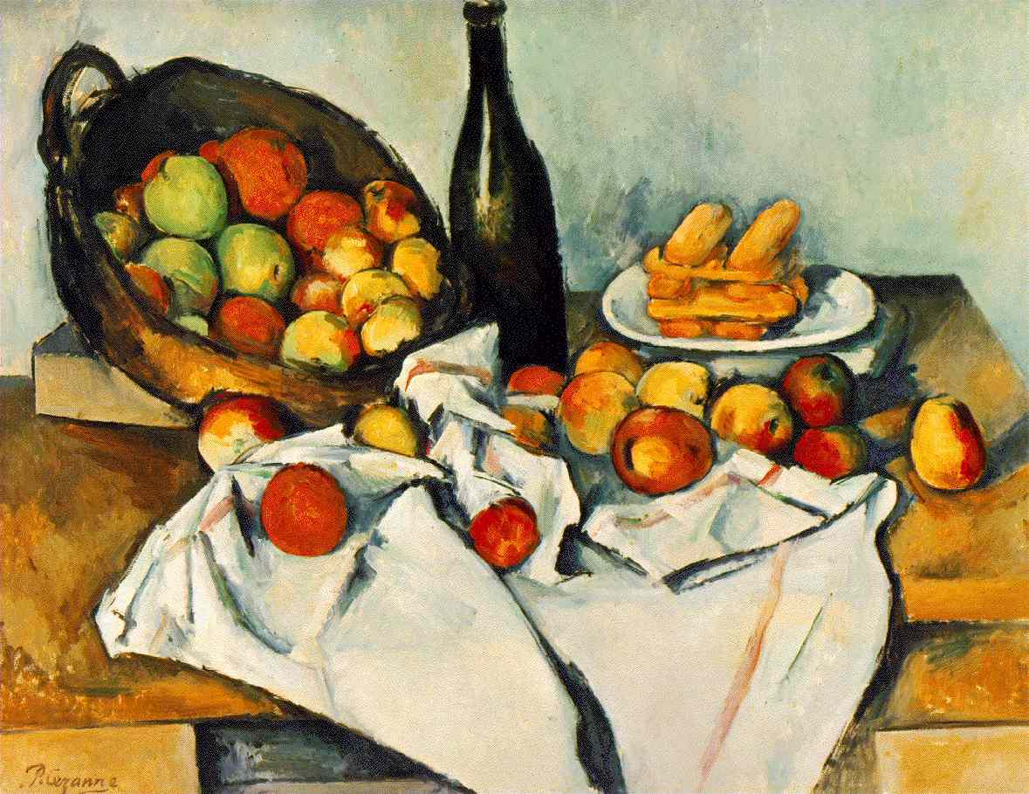
Nineteenth-Twentieth Century: Cezanne
Paul Cezanne
(French, 1839–1906)
Still Life with Basket of Apples
(1890–1904)

Slide 64
Nineteenth-Twentieth Century: Cezanne
Paul Cezanne
(French, 1839–1906)
Still Life with Basket of Apples
(1890–1904)

Slide 65
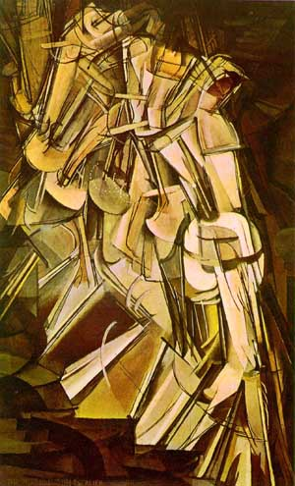
Twentieth Century: Duchamp
Marcel Duchamp (American, 1887–1968)
Nude Decending a Staircase No. 2 (1912)
Notes:
Perspective isn’t evolutionary; it’s a choice.
Marcel Duchamp (1887-1968; American, born in France)
Nude Decending a Staircase No. 2
1912
Philadelphia Museum of Art
Oil on canvas, 146 x 89 cm
Fauvism, Dada (Mona Lisa with moustache), passes through “dynamic cubism” (cf. multiple-exposure photography)

Slide 66
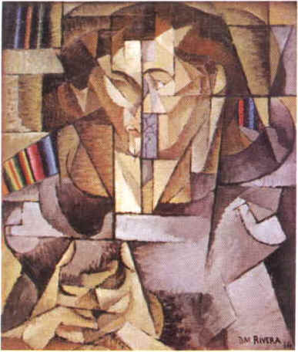
Twentieth Century: Rivera
Diego Rivera (Mexican, 1886–1957)
Portrait of Jacques Lipschitz (1914)
Notes:
Diego Rivera, Mexican, 1886–1957. Portrait of Jacques Lipschitz, 1914. The sculptor Jacques Lipschitz, The Man in the Sweather, was a close friend of Diego, and with him in Mallorca and Barcelona at the beginning of WWI.
http://www.fbuch.com/cubism.htm
Influence of Analytic Cubism, Picasso and Braque, 1907–14

Slide 67
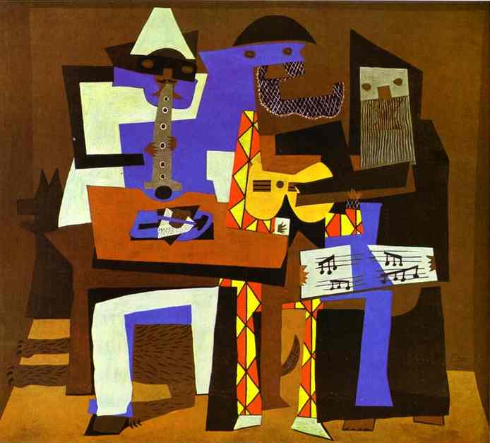
Twentieth Century: Picasso
Pablo Picasso (Spanish, 1881–1973)
Three Musicians
(1921)
Notes:
Pablo Picasso. Three Musicians. 1921. Oil on canvas. The Museum of Modern Arts, New York
http://www.abcgallery.com/P/picasso/picasso199.html

Slide 68
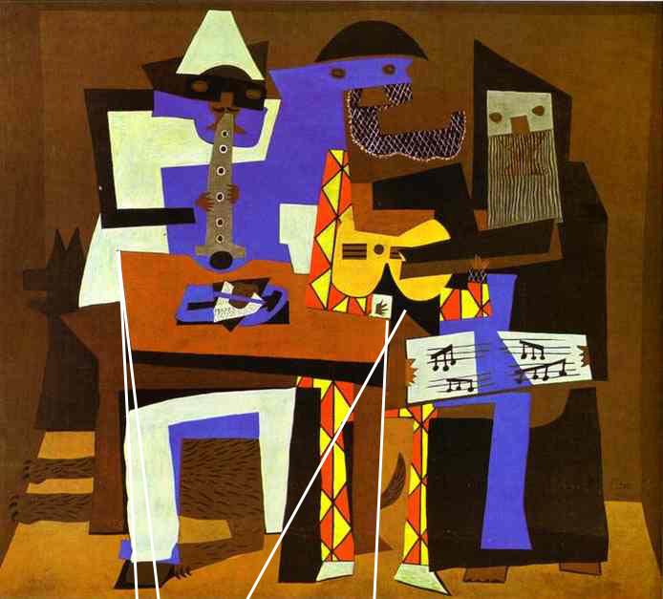
Twentieth Century: Picasso
Notes:
Pablo Picasso. Three Musicians. 1921. Oil on canvas. The Museum of Modern Arts, New York
http://www.abcgallery.com/P/picasso/picasso199.html

Slide 69
Russian Saints
Iconostasis (Иконостас)
(God the Father)
Christ (Исус Христос)
Mary (Mother of God, Theotokos Богородица)
Deësis (Деисис)
St. Nicholas the Wonder-Worker (Св. Николай Чудотворец)
St. George (Св. Георгий)
Elijah the Prophet (Илья Пророк)
St. Paraskeva-Friday (Св. Параскева-Пятница)
Festal icons (Праздничная икона)
Notes:
glossary of saints and Christian feasts on course web site, with page references to Ivanits
Christ: awesome heavenly ruler (but sometimes also mild figure); when a child, often depicted as a small (usually mild) adult
Mary: "mother of God" more important than Virgin, intercedes on behalf of mankind
Nikolai: most merciful of the saints, major intercessor (lower classes)
George: popular warrior saint (upper classes), saves maiden (Lizaveta) from dragon; livestock and wild animals
Elijah: stern, similar to Perun, rides fiery chariot, throwing lightning bolts at devil (and sometimes destroying fields in the process)
Paraskeva: popular women's saint, associated by Rybakov with Mokosh'; feast on Oct 28 is marriage season and winter women's work (spinning), punishes those who spin or otherwise work on holy Fridays by injuring their eyes or hands (parts needed to spinning); fertility. Third-century virgin martyr
Cassian: selfish and mean-spirited, leap year, unlucky day (peasants refused to leave home), evil eye, fallen angel. In reality, a fifth-century holy man, founder of monasteries, associated with mischief because February 29, which happened to be his feast day, was already presumed to be unlucky.

Slide 70
Iconostasis (Иконостас)
Notes:
Moscow, Assumption Cathedral

Slide 71
Iconostasis

Slide 72
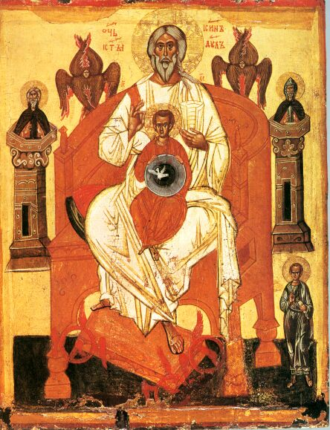
God the Father
Fatherhood
(Отечество)
Novgorod
End of xiv c.
Notes:
Lazarev, Novgorod, plate 36
Main inscription reads “Father and Son and Holy Spirit”
Both Father and Holy Spirit are labeled ΙΣ ΧΣ (avoiding heresy?)
Small figure in lower right may be donor

Slide 73
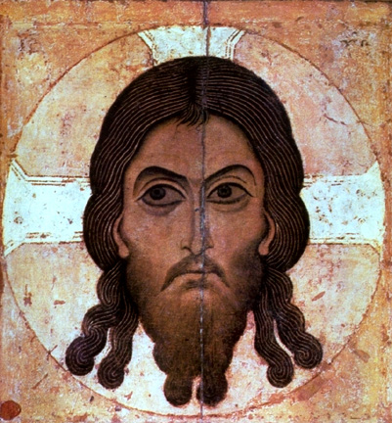
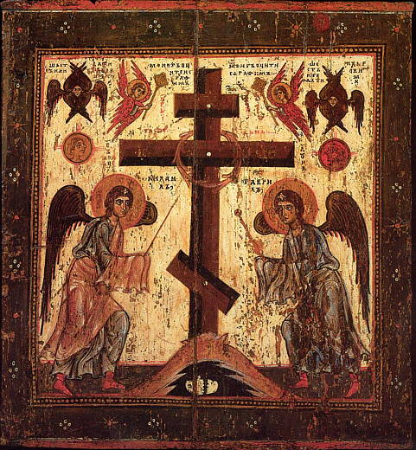
Redeemer Not Made by Hand (Спас нерукотворный)
Notes:
Spas nerukotvornyi, Novgorod School, 12th C, Tretyakov Gallery, Moscow
(traces of ΙΣ ΧΣ in upper corners)

Slide 74
Christ of the Fiery Eye, xiv c. (Спас ярое око)
Notes:
Christ of the Fiery Eye, mid 14th C, Assumption Cathedral, Moscow

Slide 75
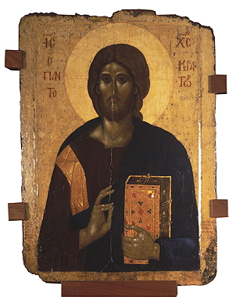
Pantocrator / Savior Enthroned in Glory (Вседержитель / Спас в силах)
Notes:
Christ Pantocrator, Pantocrator Monastery, Athos, 1363, Hermitage, http://www.hermitagemuseum.org/html_Ru/08/hm89_0_2_128_2.html
Russian, xvi c, 31 x 40 in. Metropolitan Museum of Art (Gift if George R, Hahn)
Spas v silax is modern

Slide 76
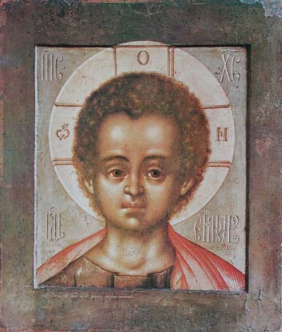
Emmanuel (Эммануил)
Notes:
Emanuel, no information, http://www.icona.ru/obraz/index.php?name=spem
1697 , Ушаков Симон Федорович (1626–1686), http://www.icon-art.info/masterpiece.php?mst_id=144

Slide 77
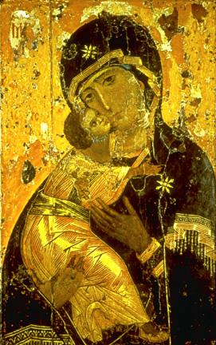
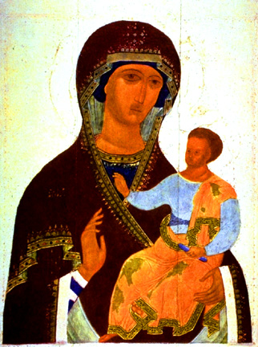
Theotokos (Богородица)
Vladimir Mother of God, xii c.
Eleousa (умиление)
Odigitria (Путиводительница) Dionysius, Moscow, xv c.
Notes:
Umilenie (eleousa) = tender mercy
Hodigitria = showing the way
Infant looks like small adult
Inscriptions were formulaic, and often Greek, not be read, but to be symbolic (Uspensky25)
Greek inscription on Vladimir Mother of God: ΜΡ ΘΥ

Slide 78
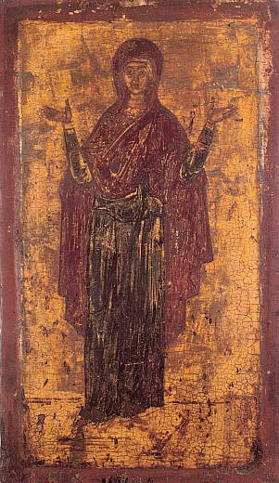
Theotokos (Богородица)
Orans (Оранта)
Sign (Знамение)
Notes:
Orans, Byz. Museum, Athens, 14th c., http://nesusvet.narod.ru/ico/icons/m_0118.jpg
Znamenie, Znamenskii sobor, Novgorod, 1st half of 12th c., http://nesusvet.narod.ru/ico/icons/m_01165.jpg

Slide 79
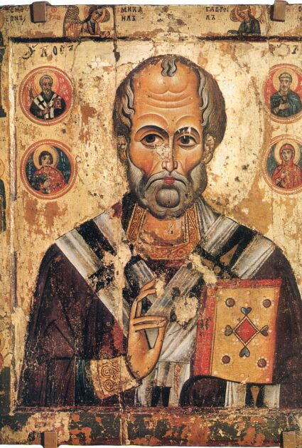
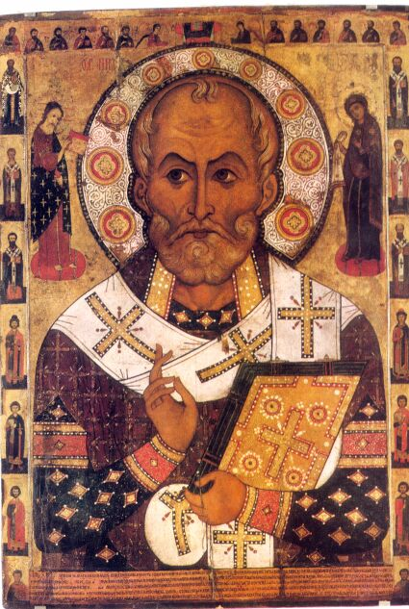
St. Nikolai the Wonder Worker (Св. Николай Чудотворец)
Notes:
Novgorodian Icon Painting, plate 14
Wood, tempera, 0.68 x 0.53, mid-xiii c
Russian Museum, St. Petersburg
Novgorodian Icon Painting, plate 16
Aleksa Petrov, 1294 (signed and dated on back!)
Wood, tempera, 1.77 x 1.29
Museum of History and Architecture, Novgorod
Figures are Christ and Mary, others are miscellaneous saints
Two feast days: December 6 and May 9
Favorite saint of the peasantry
Merciful helper and wonder-worker
Protector of livestock and grain
Patron of merchants, fishermen, and seafarers
Inherits the pagan cult of Volos/Veles

Slide 80
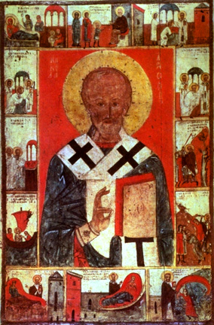
St. Nikolai with Scenes of his Life (Св. Николай в житиях)
Novgorod
Late xiii–Early xiv c.
Notes:
Comic-strip approach with multiple representations

Slide 81
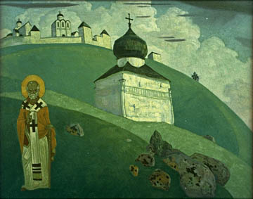
St. Nikolai the Wonder Worker
Nikolai Rerich (1874–1947)
Nikola (1916)

Slide 82
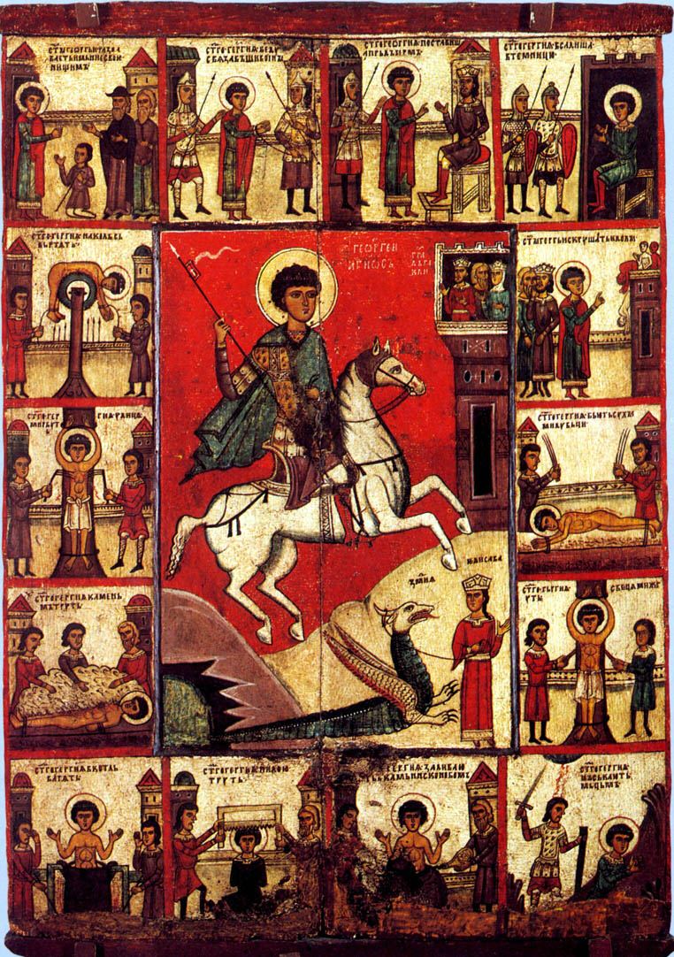
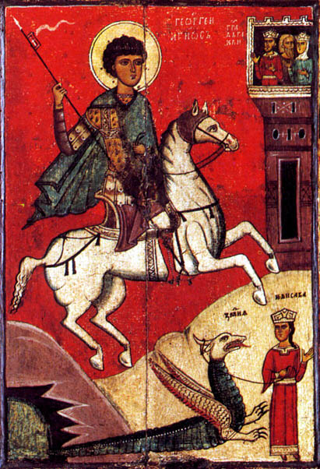
St. George (Св. Георгий в житиях)
Notes:
“Novgorodian Icon Painting,” plate 17
St. George. Wood. Early xiv c.
Center of hagiographic icon, full version of which is in Lazarev, Novgorod volume, plate #30
George is bigger not only than Elisava, but also than this horse and than a building
Not slaying, or even looking at dragon (summation before they meet?)

Slide 83
St. George
Novgorod School
xv c.
Notes:
Two feast days: November 26 and April 23
Favorite saint of the nobility
Holy warrior, dragon slayer, savior of the maiden Lizaveta (Russia)
Patron of livestock, shepherds, wild animals
Spring feast: first day of driving cattle out to pasture
Connected with the pagan cults of Volos/Veles and Perun

Slide 84
Leon Trotskii as St. George
Viktor Deni, 1920
Notes:
Slaying the dragon of counter-revolution
Poster by Victor Deni, 1920
http://www.fbuch.com/posters.htm

Slide 85
Elijah the Prophet (Илья Пророк)
Notes:
Elijah in the desert (N Russia)
Elijah (Moscow school?)
Feast day: July 20
Awesome, punitive
Enemy of the Devil, destroyer of the unclean force
Associated with thunder and lightning
Chariot rider
Inherits the function and personality of Perun

Slide 86
Elijah the Prophet
Palekh School
Early xviii c.
Notes:
Elijah the Prophet with scenes of his life and his fiery ascension
Palekh School, early 18th c
Wood, gesso, tempera, gilded
“Palekh Icon Painting,” Plate 37

Slide 87
St. Paraskeva-Friday (Св. Параскева-Пятница)
Notes:
3rd century virgin martyr
Novgorod, xiii c.
c. 1700, rural church
White headdress = virginity, angelic crown and cross = martyrdom
Scroll says “I believe in one God …”
Upper left corner is Spas nerukotvornyi
http://sacredartgallery.com/Saint%20Paraskeva%20Piatnitsa.htm
Feast day: October 28
Twelve Fridays
Protector of women and women’s work
Associated with water (springs) and vegetational fertility
Links with the pagan cults of Mother Damp Earth, and Mokosh′

Slide 88
Festal Icon (Праздничная икона)
Notes:
Moscow school, ca. 1800
http://digilander.libero.it/chiometta/sedici2.jpg
http://digilander.libero.it/chiometta/sedici4.jpg
Links from http://digilander.libero.it/bianco14/01e.html

Slide 89
Finis

